Slide 1
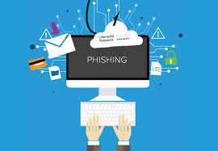
By JOHN ODI ETTA M00783479

Slide 2

CONTENTS
Introduction
What is Phishing
How does phishing work
Types of phishing
Effects of phishing
How to identify a phishing email
Countermeasures
Critical Analysis
Conclusion
Reference

Slide 3
INTRODUCTION
Phishing is the most powerful and popular attack for hacking into emails and web accounts.
Attackers use social engineering techniques to deceive users into divulging sensitive information via phishing websites
Most cyber attacks have an element of phishing as an underlying cause.
Knowledge of phishing is important in mitigating it.

Slide 4

WHAT IS PHISHING
Phishing is a technique scammers and hackers employ to acquire information from unsuspecting internet users.
The main objective of a phishing scam is for criminals to acquire sensitive information. Credit card numbers, social security numbers, login information to certain websites, passwords, and even cell phone numbers are among the most common types of information cyber criminals attempt to acquire.

Slide 5
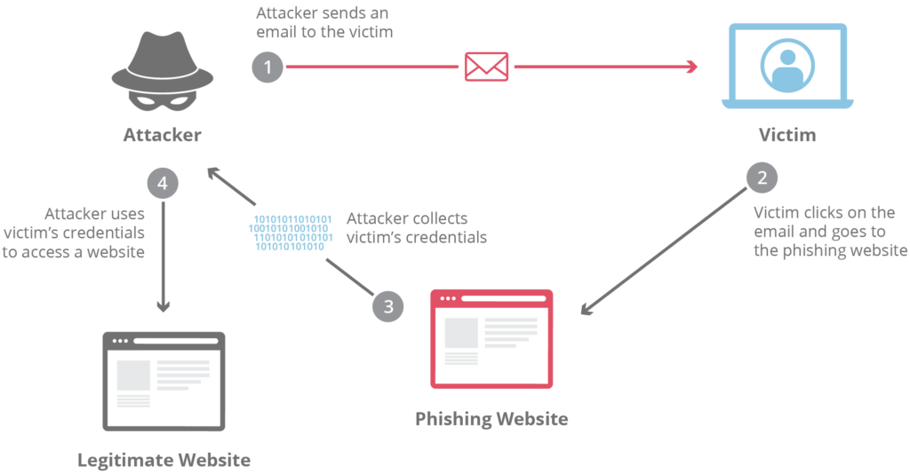
HOW PHISHING WORKS

Slide 6
TYPES OF PHISHING
DECEPTIVE PHISHING
Deceptive phishing technique is associated with the use of social engineering schemes, which depends mostly on forged email claims that seem to originate from a legitimate individual, company, or bank. Through an embedded link within the email, the phisher attempts to lure and redirect victims to fake Websites.
MALWARE PHISHING
Involves technical schemes that depend on malicious code or malware as remote access tools to gain access via a backdoor to the user system either by downloading an email attachment or after the user clicks on an embedded email link .

Slide 7
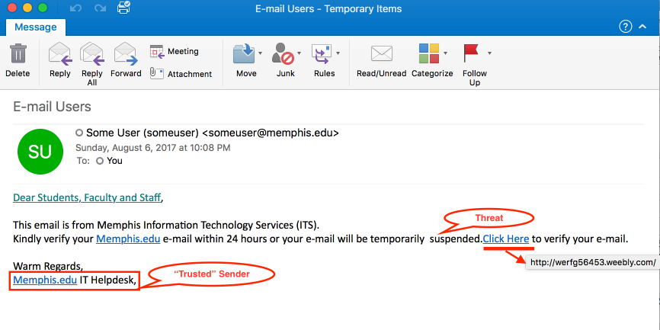

EXAMPLES OF PHISHING EMAILS

Slide 8
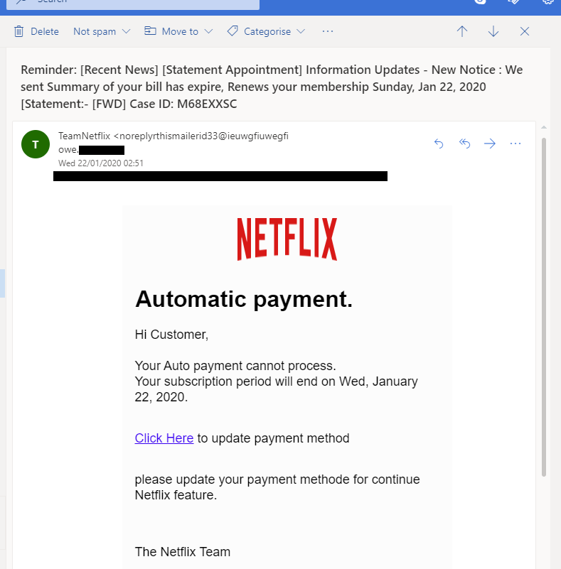
EXAMPLES OF PHISHING CNTD.

Slide 9
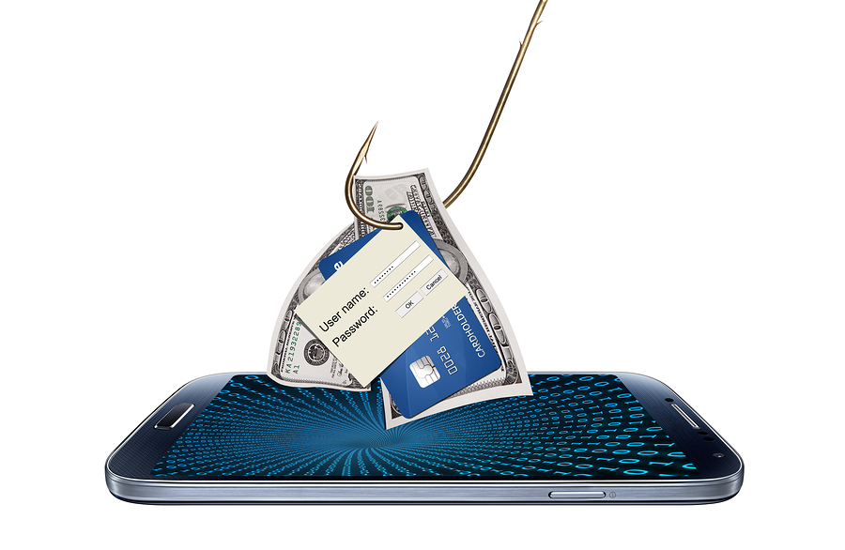
EFFECTS OF PHISHING
:
1
Internet fraud
2
Identity Theft.
3
Financial loss to Victims

Slide 10
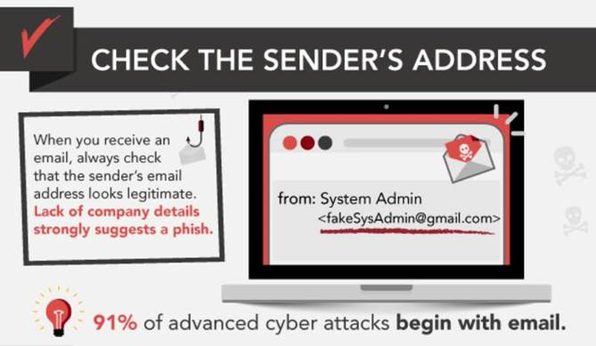
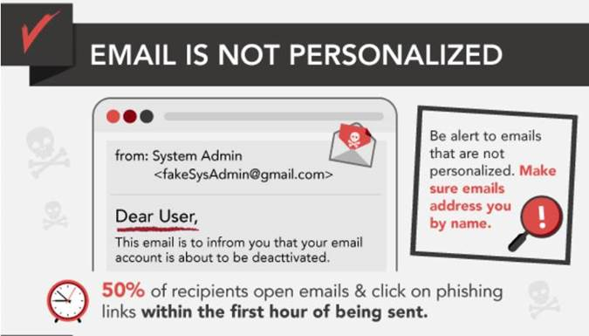
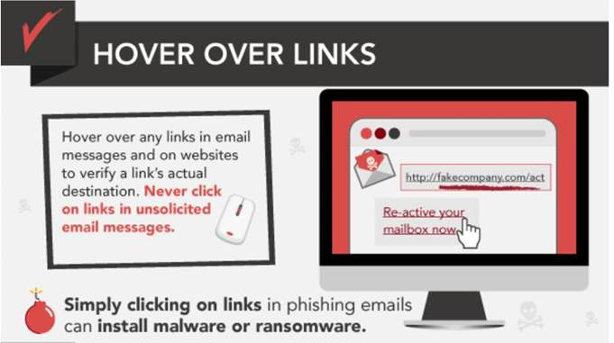
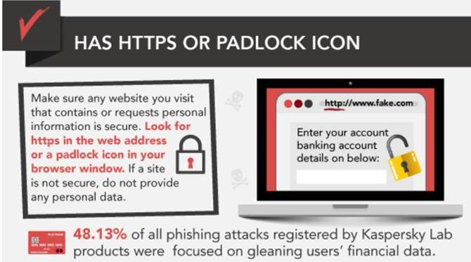
HOW TO IDENTIFY A PHISHING EMAIL

Slide 11

COUNTERMEASURES
Web and Email security
Malware Protection
Access Controls
End User Education

Slide 12
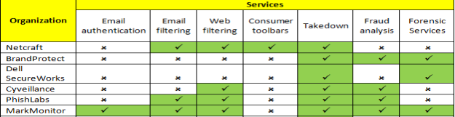
CRITICAL ANALYSIS

Slide 13

CONCLUSION
Currently not a single technology or technique can completely stop phishing
The combination of good security practice, proper application and implementation of current and improving security technology can greatly reduce the risk of phishing attacks.
User education is key.

Slide 14

REFERENCE
www.google.com
www.Wikipedia.org
H. Huang, J. Tan and L. Liu, "Countermeasure Techniques for Deceptive Phishing Attack“.
Antonio San Martino & Xavier Perramon” Phishing Secrets: History, Effects, and Countermeasures”.

Slide 15

THANK YOU

